Slide 1
CHAPTER 8
INTERNET
AND
CONVERGED NETWORKS

Slide 2
TCP/IP Model
The TCP/IP protocol suite emerged from research under the auspices of DARPA
Originally designed for the Internet but it is equally adaptable for a close network such as a LAN
The widest accepted set of protocol in the telecommunications industry, implemented in both LAN and WAN environments

Slide 3
Benefits of TCP/IP protocol
Ease with which it can be configured, managed, maintained and scaled
Higher flexibility than any other protocol
Good error-detection and recovery mechanisms
Broad appeal,especially because of the growing popularity of the Internet

Slide 4
Transmission Control Protocol (TCP)
Transmission Control protocol (TCP) is a Layer-4 (transport-layer) reliable, connection-oriented, unicast (point-to-point), guaranteed delivery protocol that performs end-to-end error checking, correction and acknowledgement
  Connection-oriented means connection must be established prior to data transfer
Ensures that data is delivered error-free with no loss or duplication
Applications that use TCP include FTP (File Transfer Protocol), HTTP, TELNET and SMTP (Simple Mail Transfer Protocol)

Slide 5
User Datagram Protocol (UDP)
User Datagram Protocol (UDP), is also a Layer-4 (transport-layer) protocol like TCP. In comparison to TCP, it is an unreliable, connectionless protocol, but with less overheads
  Connectionless means data transfer on a best-effort basis
Applications such as SNMP (Simple Network Management Protocol) and RTP (Real-time Transport Protocol) use UDP

Slide 6
Internet Protocol (IP)
The Internet Protocol (IP), equivalent to Layer 3, segments and packets data for transmission and then places a header for delivery. The IP header is in addition to the TCP or UDP header appended to the application data
The IP header includes the source and destination addresses, enabling an end-to-end data flow

Slide 7
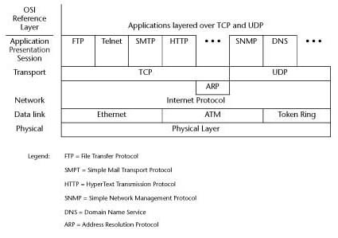
Correlation Between
TCP/IP and OSI Layers

Slide 8
IP Version 4 (IPv4) Addressing
The IP version 4 (IPv4) addressing requires a unique, 32-bit address to be assigned to each host connected to an IP-based network. The basic addressing scheme is a two-level hierarchy, represented below:
Class Network | Host
Two-level IP Addressing Hierarchy

Slide 9
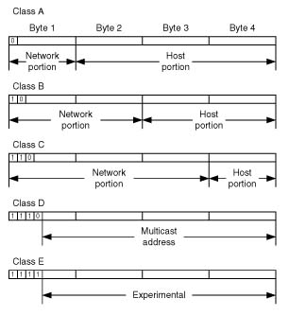
Five Network Classes Supported in IPv4

Slide 10
Internet Assigned Numbers Authority (IANA)
Internet Assigned Numbers Authority (IANA) is responsible for three things:
  Assigning IP addresses, that is, the four octets to identify every Internet router, server and workstation
  Running the root name servers that provide the essential base for the Domain Name System (DNS)
  Acting as final arbiter and editor for key standards developed by the Internet Community
IANA developed the Dotted Decimal Notation
  A technique used to express IP addresses via the use of four decimal numbers separated from one another by decimal points

Slide 11
Dotted Decimal Notation
Dotted Decimal Notation
  Divides the 32-bit IP address into four 8-bit (one-byte) fields or octets, with each specified as a decimal number
  The decimal number for octets 2, 3 and 4 can range from 0 to 255
  In the first octet, the setting of the first few bits for the “Class address” limits the range of decimal values

Slide 12
Domain Name Identifiers
For example the domain name www.ilstu.edu has an IP address of 138.87.4.3. The last identifier in the domain name, that is the edu part of the domain, reflects the purpose of the organization or entity. In the U.S., classical domain name identifiers are:
com for commercial organization
edu for educational institutions
gov for governmental organizations
mil for military units
net for network access providers
org for nonprofit organization
int for organizations formed under international treaty

Slide 13
Subnets
Through the process of subnetting, the two level hierarchy of class A, B and C networks is turned into a three-level hierarchy. In doing so the host portion of an IP address is divided into a subnet portion and a host portion.

Slide 14
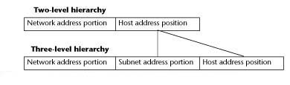
Two-level versus Three-level Hierarchy Using Subnets

Slide 15
Classless Addressing
Classless addressing
  Extends the availability of IP addresses
  Enables routers to operate more efficiently
  Uses a variable address space (depending upon the needs of the organization), which provides access to the organization’s network, referred to as a super-network
  Improves efficiency through a “assign only what’s needed” approach

Slide 16
IP version (IPv6)
IP version 6 (IPv6) has been developed to extend source and destination addresses and provide a mechanism to add new operations with built-in security
Although IPv4 is still widely used, over the next few years, the IPv4 32-bit address will be replaced with the IPv6 128-bit address
In addition to unicast and multicast addresses, IPv6 uses an anycast address, which provides the possibility of routing to the nearest gateway
Slow adoption of IPv6 is attributed to the enormous difficulty in changing network-layer protocols

Slide 17


IPv4 versus IPv6 Packet Format

Slide 18
TCP/IP Applications
SMTP (Simple Mail Transfer Protocol)
Post Office Protocol
Multipurpose Internet Mail Extensions (MIME)
Internet Message Access Protocol (IMAP)
Point-to-Point Protocol (PPP)
Serial Line Internet Protocol (SLIP)

Slide 19
TCP Via Satellite
TCP is not well-suited for satellite transmission because it employs an algorithm known as slow start, which uses the sliding-window protocol
  Slow Start
    Initial window size is only 512 bytes, and increases only when packets are delivered successfully and ACK arrives
  Sliding-window
    Must contain adequate buffering to re-sequence packets between two hosts
  Spoofing
    A way around slow start, where the spoofing box provides premature ACK, and asks for re-transmittals when needed
Throughput = Window Size/Round-trip Time

Slide 20
Internet2
Internet2 is an outcome of collaborative efforts to address the increasing need for greater bandwidth and sustaining a cutting-edge network capability vital to the nation’s leading position in technology
I2 helps to alleviate traffic jams through the creation of a limited number of regional hubs, called Giga-POPs, which serve as access points for high-performance networks

Slide 21
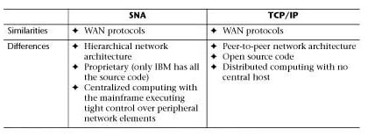
SNA versus TCP/IP

Slide 22
Virtual Private Network (VPN)
VPNs are encrypted tunnels through a shared private or public network, and are very cost-effective as compared to dedicated or leased lines.
  Tunneling is the process of encrypting and then encapsulating the outgoing information in IP packets for transit across the Internet and reversing the process at the receiving end.
  Encryption involves scrambling of data by use of a mathematical algorithm.

Slide 23
VPN Tunnels and Protocols
LAN-to-LAN or site-to-site tunnels
  Usually corporate environments, where users on either LAN can use the tunnel transparently to communicate with one another
Client-to-LAN tunnels
  Need to be set up, so the client must run special software to initiate the creation of a tunnel and then exchange traffic with the corporate network
Virtual Private LAN Service (VPLS)
  A class of VPN that connects multiple sites over a managed IP/MPLS network to form a single bridged domain
VPN Protocols
  Leading protocols are: PPTP, L2TP, and IPSec

Slide 24
Intranet and Extranet
Intranet
  A private network that uses TCP/IP and other Internet protocols but is contained within the enterprise
  Intranet VPNs link corporate headquarters with branch offices
Extranet
  An Intranet that allows controlled access by authenticated outside parties to enable collaboration across multiple organizations
  Extranet VPNs link corporate partners, suppliers, customers, and investors

Slide 25
Converged Networks
Converged Data/Voice networks
  Application of voice digitization and compression techniques to enable voice transmission over networks originally developed to transport data
Characteristics of Converged Data/Voice Networks
  Low delay, Echo cancellation, Latency and Jitter for voice
  Call-completion ratio
  Intelligent network services like AA, caller ID, hunt groups
  Interface with standard telephone sets
  Handle megabit data streams for video
  Low error rates for data
  Strong security for mission-critical data

Slide 26
Voice over IP (VoIP)
VoIP is transmitting telephone calls over the Internet rather than through the traditional telephone system
PSTN and IP Internetworking
  Assured Quality Routing (AQR) marries packet and circuit switching to automatically reroute calls to the PSTN when parameters do not meet accepted ranges
VoIP Call Process
VoIP QoS
  Jitter buffer discards and bursts (varying periods of packet loss), are concealed by PLC-enabled vocoders
  IETF is working on two protocols: DiffServ and MPLS

Slide 27
Voice over Frame Relay
Frame Relay Access Devices (FRADs) converge voice and data traffic onto a single Frame Relay trunk
FRADs process frames by traffic priority and maximum elapsed time in queue
Since queuing is directly dependent on frame size, Frame Relay segmentation segments all traffic (voice and data) to a fixed size frame or cell

Slide 28
Voice over ATM
Voice over ATM supports multiple classes of service to obtain the predictability and reliability required for end-to-end transmission of voice, data and video. Each traffic class is based on three key attributes:
  Timing relationship between source and destination
  Variability of the bit rate
  Connection mode

Slide 29
Multimedia over IP Protocols
Real-time Transport Protocol (RTP)
  Streaming mode versus Buffered mode
Resource Reservation Protocol (RSVP)
  Ensures QoS for real-time IP data at Layers 3 and 4
Open Settlement Protocol (OSP)
  Handles authentication, authorization, call routing and call detail over IP networks
Session Initiation Protocol (SIP)
  IETF proposed standard for multimedia call sessions
H.323
  Represents an umbrella standard originally developed for multimedia videoconferencing

Slide 30
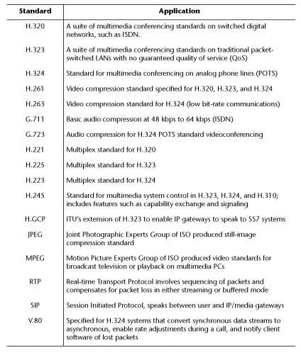
Multimedia
Standards and
Applications

Slide 31
Data Compression
Data compression is the storing of data in a format that requires less space than usual
It is used to reduce the number of bits that must pass over the communications medium in order to reduce transmission time
Two categories of data compression schemes:
  Lossless: Used for text transmission
  Lossy: Used for image transmission

Slide 32
Run–Length Encoding
RLE
  Simple form of lossless data compression encoding
  Uses a string coding method for compacting redundant data
  Cannot achieve high compression ratios
  Common example: fax modem

Slide 33
RLE Principle and an Example
The RLE principle is that the run of characters are replaced with the number of the same characters and a single character
Example:
D T A A A A R F E E E E E
RLE compression:
DT*4A RF*5E

Slide 34
Huffman Code
A lossless technique, that uses a variable length code, where the code of each character has a unique prefix
Huffman’s scheme uses a table of frequency of occurrence for each symbol (or character) in the input

Slide 35
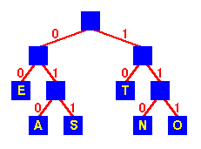
Huffman’s Binary Tree
Example of an encoding tree for E, T, A, S, N, O
String Encoding
SEA 011 00 010
NOT 110 111 10
TEN 10 00 110

Slide 36
Transform Coding
A lossy image coding technique that is implemented in four stages:
  Image Subdivision
    Subdivide n x n image into smaller n x n blocks
  Image Transformation
    Image is represented in a new domain, where a reduced number of coefficients contains most of the original information
  Coefficient Quantization
    Reduces the amount of data used to represent the new information
  Huffman Encoding
    Lossless technique that encodes the data and further reduces the total number of bits

